Slide 1


IMDb TV SERIES
2429397 Ecehan Vergiliel
2501955 Emine Doğa Aşkın
2428902 İlayda Berra Belim
2428936 Can Bulut
2429090 Mehmet Egemen Gündür

Slide 2







DATA
Data source.
Data description, originality.
Why did we choose this data?
How did we clear and convert it?
Data structure.

Slide 3

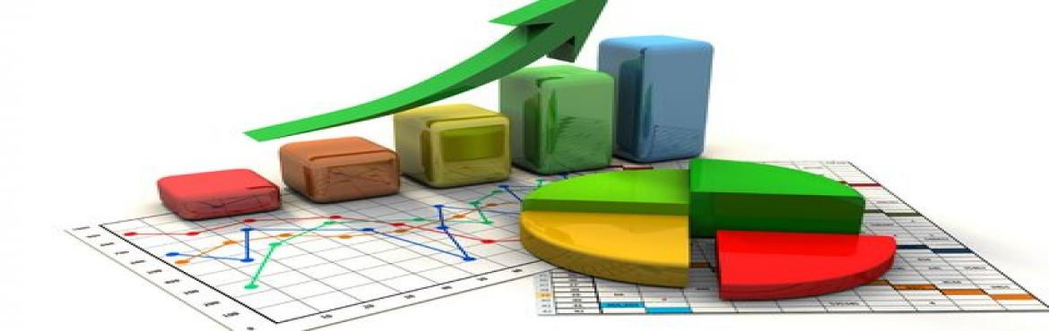
Research Questions
Which genres have been watched the most?
01
Is there any relation between ratings and votes? If yes, how can we describe this relation?
02
Which type of tv series do countries produce the most?
03

Slide 4
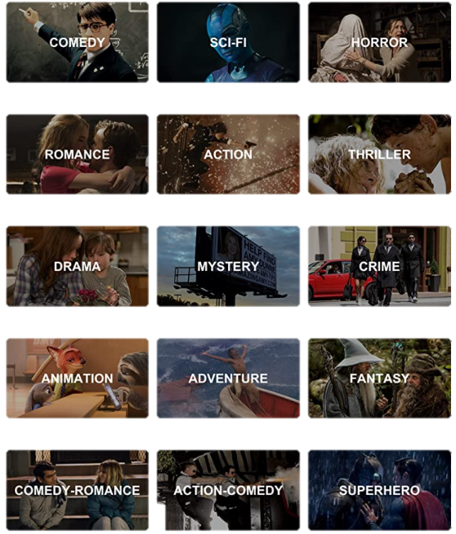
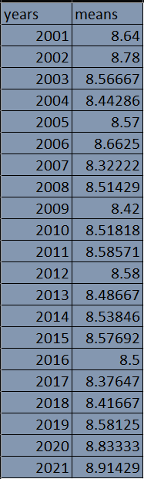
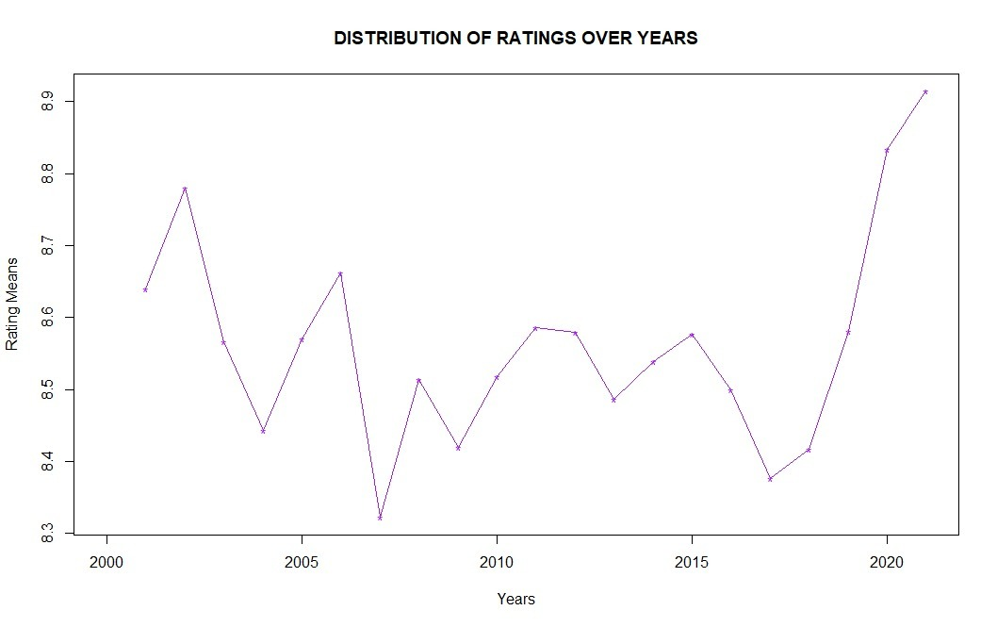
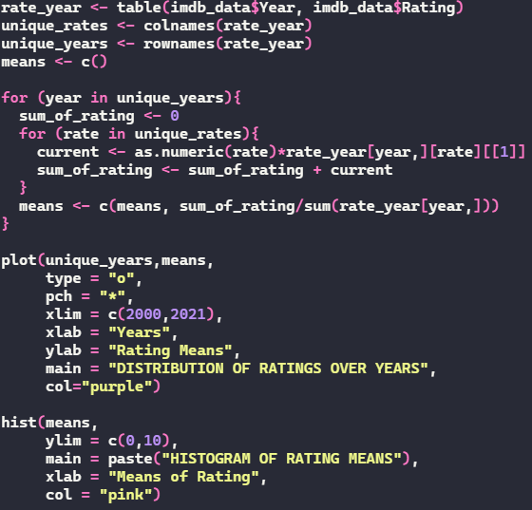
Question #1: Which genres have been watched the most?
Graph #1

Slide 5
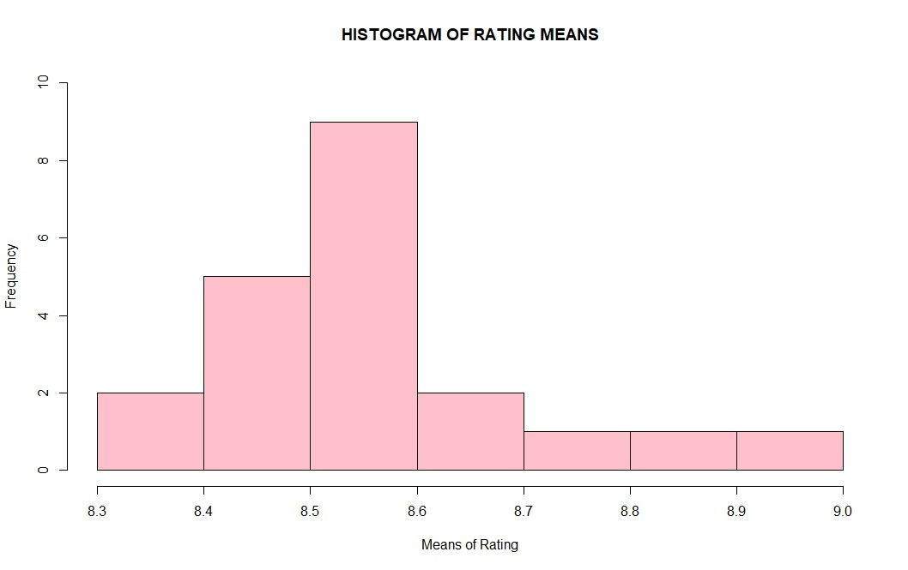
The graph #1 takes the largest value in 2021 and the smallest value in 2008.
Moreover, our graph has the line that is connecting the data points, which make it easy to read the data and see the difference between the years.
The graph #2 is a histogram, which shows the rating means, is skewed right. You can see on the right side the frequencies are bigger than the rest.
The minimum value of the means of ratings is 8.322 and the greatest value of means of ratings is 8.914. Therfore, the overall range is approximately 0.592.
Graph #2

Slide 6
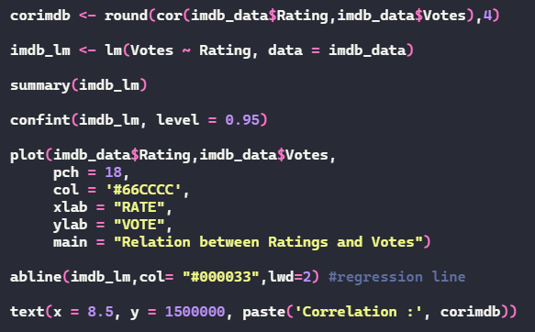
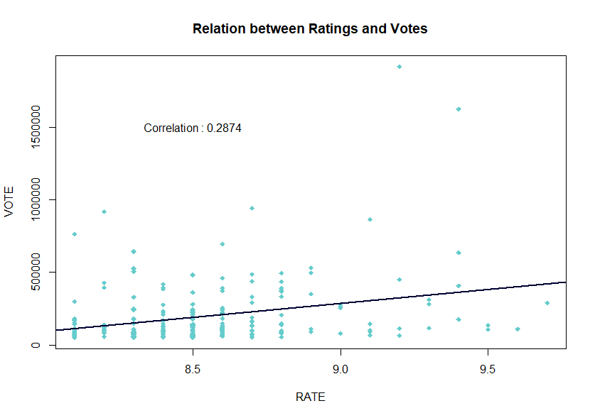
Question #2: Is there any relation between ratings and votes? If yes, how can we describe this relation?
This plot defines the relationship between Ratings and Votes.
The corrolation coefficent is approximately 0.28 so it means that there is a moderate positive relationship between votes and rates. In other words, there is a weak uphill linear relationship.

Slide 7

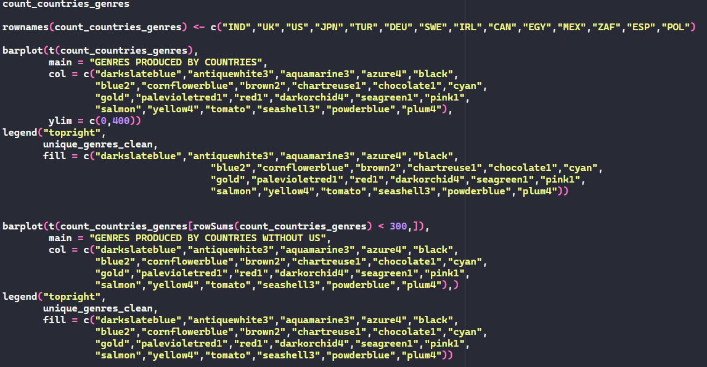
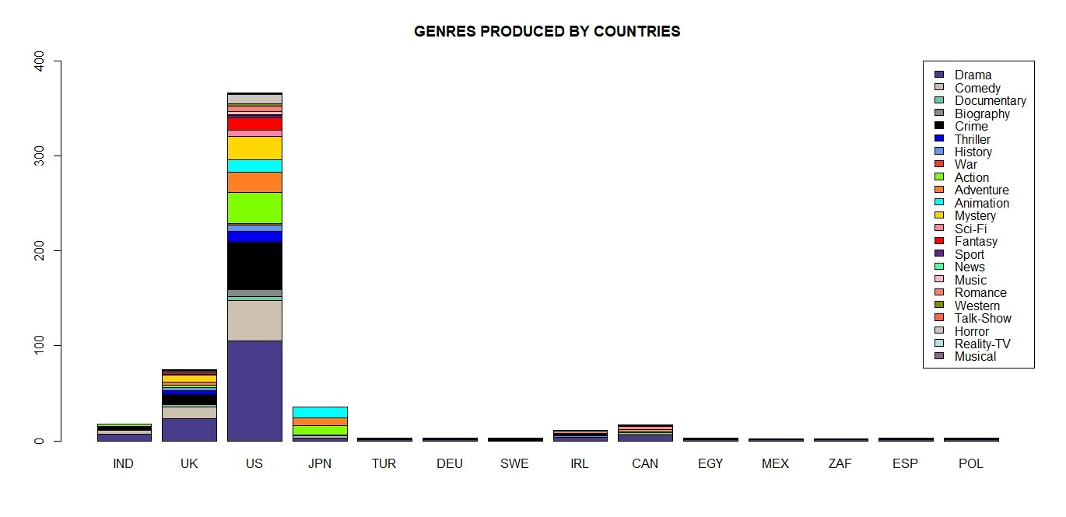
Question #3: Which type of tv series do countries produce the most?
Our last question is about the type of TV series countries have produced the most.

Slide 8
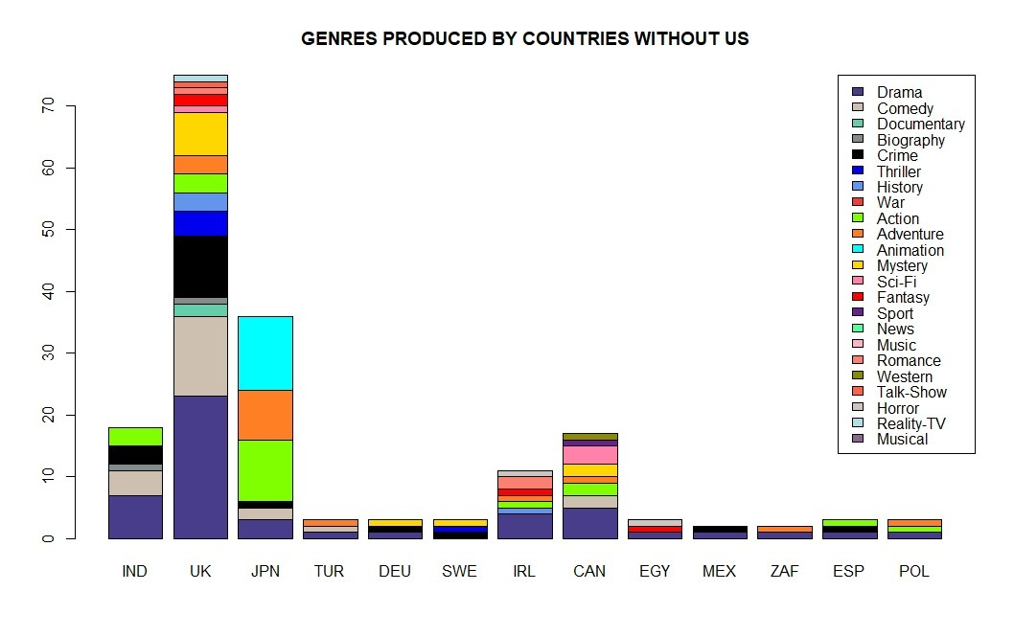
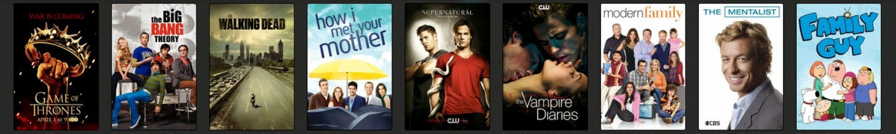
We observe that UK and US are the biggest producers, also we can see that the first five most preferred genres are the same. They both produced drama, comedy, documentary, crime, biography, and thriller. Additionally, one of the things that stood out the most was Japan's most produced genre, animation.

Slide 9
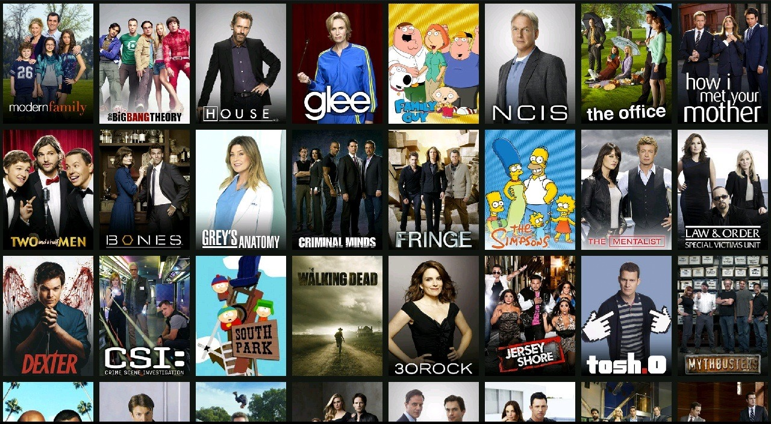

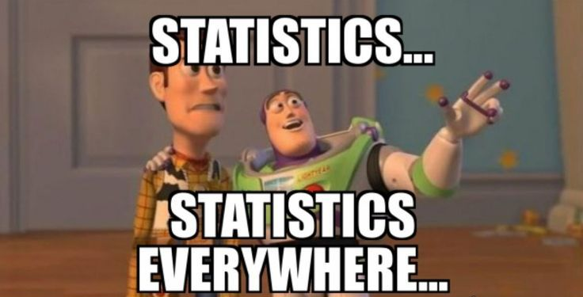
DISCUSSION
Results and Findings
Comments.
Conclusion.

Slide 10
REFERENCES
1-) Movies and Series Rankings (IMDB Data). Meta Data
http://metabase.intellimenta.com/public/dashboard/eae564a4-d9a3-46b1-9cd4-1f95ab5b1b18?item_type=Series&years_%253E_%253F=2000&rating____=8&__votes____=50000
2-) IMDb Help Center
https://help.imdb.com/article/contribution/titles/runningtimes/G8UMSUYEDCN3M2K8?ref_=helpms_helpart_inline#
3-) Plot colors:
http://www.sthda.com/english/wiki/colors-in-r
http://www.stat.columbia.edu/~tzheng/files/Rcolor.pdf

